Slide 1
Pre-Workshop Prep
Download example files: https://osf.io/ywv39/files/
Login to OSF: https://osf.io
Click “Sign In”
Click on “Login through Your Institution”
Select “University of Virginia” and login through Netbadge

Slide 2
Research Management and Reproducible Practices
An Introduction to the
Open Science Framework
Ricky Patterson, Associate Director, Campus-Wide Partnerships & Services
Sherry Lake, Scholarly Repository Librarian
University of Virginia Library

Slide 3
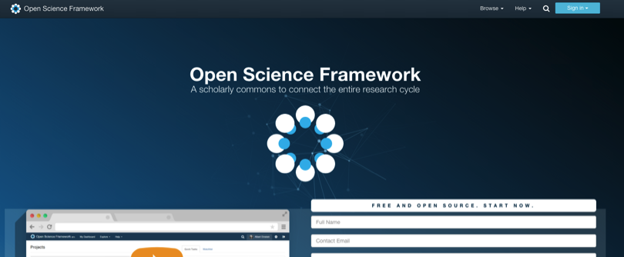
OPEN SCIENCE FRAMEWORK
http://osf.io
FREE, OPEN SOURCE
Notes:
[30 sec - to 1 min]

Slide 4
Notes:
GINNY
[30 sec - to 1 min]

Slide 5
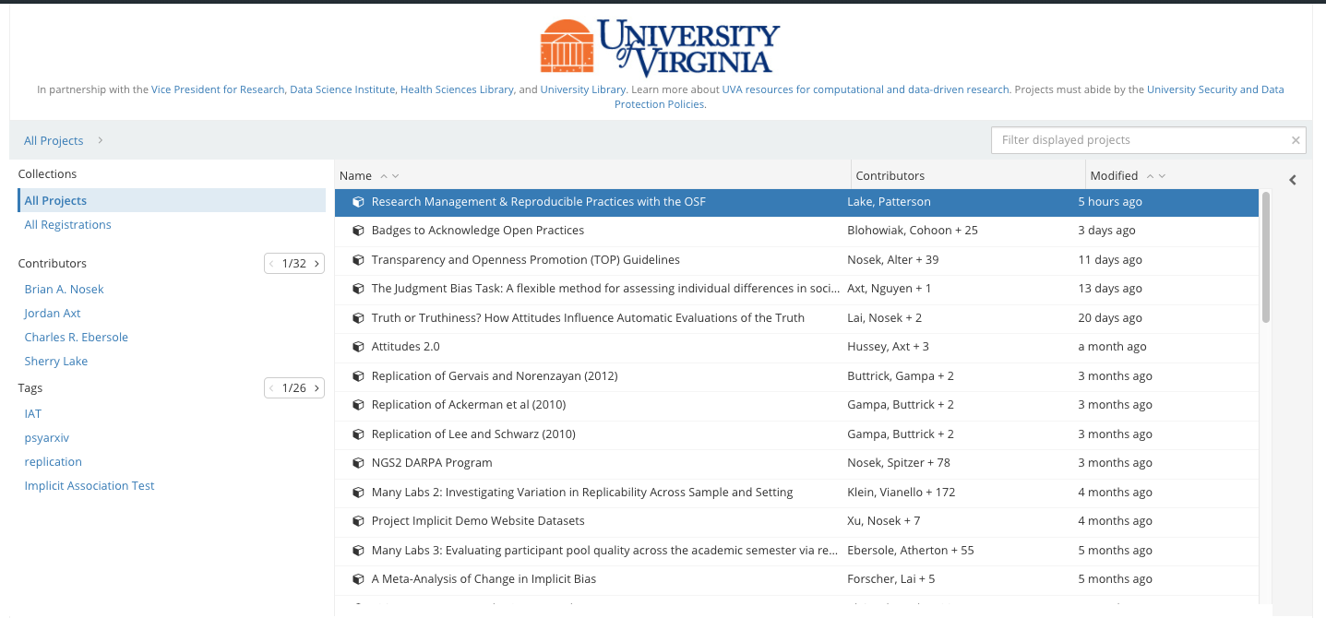
OPEN SCIENCE FRAMEWORK for UVA
https://osf.io/institutions/uva/
Notes:
GINNY
[30 sec - to 1 min]

Slide 6
WHY USE THE OSF?
Supports research management
More easily share research with collaborators, funders, institution, etc as you see fit
Control over how files/components are shared (e.g. read-only, read-write)
See how others engage with your research
User-friendly
But it is just a tool, and the methodology we discuss today can be applied on your own with other tools. The OSF just gathers these best practices into one place.
Notes:
[1-2 min]
-OSF supports research management - Why is research management important?
---> Example of request for audit, etc., NIH (other funder) reporting, etc.
-Freeze files / page components
---> To demonstrate following of an a priori design
-OSF does what you can do on GitHub, Google Drive, etc., but does it in one project platform → especially because of the connections it has/can make to other tools
-Don’t have to continually send out things to these other tools - everything is here.
-OSF places no limits on who and how many people you invite (beyond your own choice)
-It provides analytics of usage and engagement (even how long people spend on the project, etc.)
-User-friendly
Reproducibility [2 min]
-OSF supports project management for easy reproducibility
-Importance of reproducibility of research

Slide 7
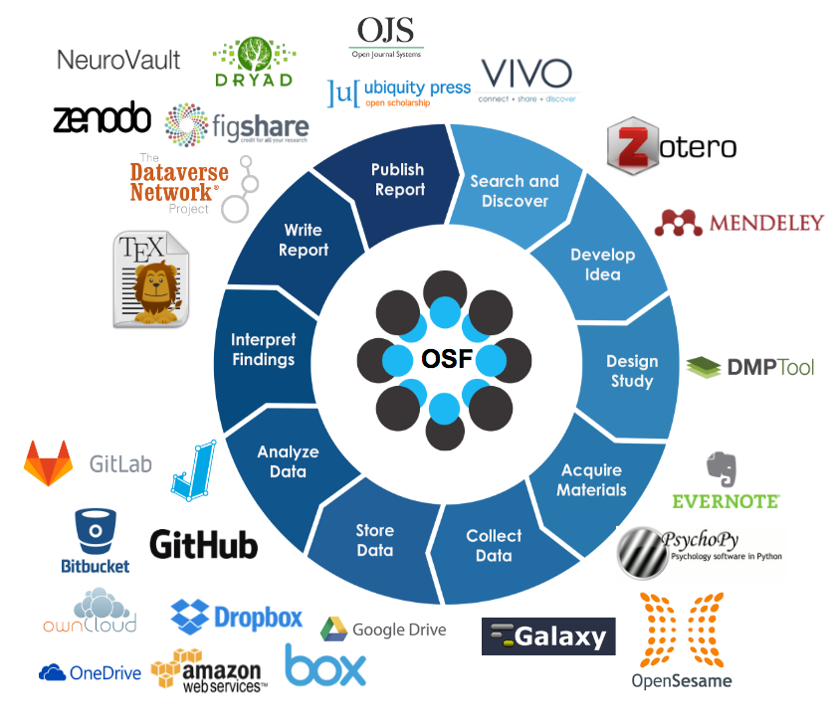
WHY USE THE OSF?
Connects to many tools (e.g. GitHub, Google Drive), to better allow collaboration across online applications
Enhance reproducibility and rigor in your research
Notes:
[1-2 min]
-OSF supports research management - Why is research management important?
---> Example of request for audit, etc., NIH (other funder) reporting, etc.
-Freeze files / page components
---> To demonstrate following of an a priori design
-OSF does what you can do on GitHub, Google Drive, etc., but does it in one project platform → especially because of the connections it has/can make to other tools
-Don’t have to continually send out things to these other tools - everything is here.
-OSF places no limits on who and how many people you invite (beyond your own choice)
-It provides analytics of usage and engagement (even how long people spend on the project, etc.)
-User-friendly
Reproducibility [2 min]
-OSF supports project management for easy reproducibility
-Importance of reproducibility of research

Slide 8
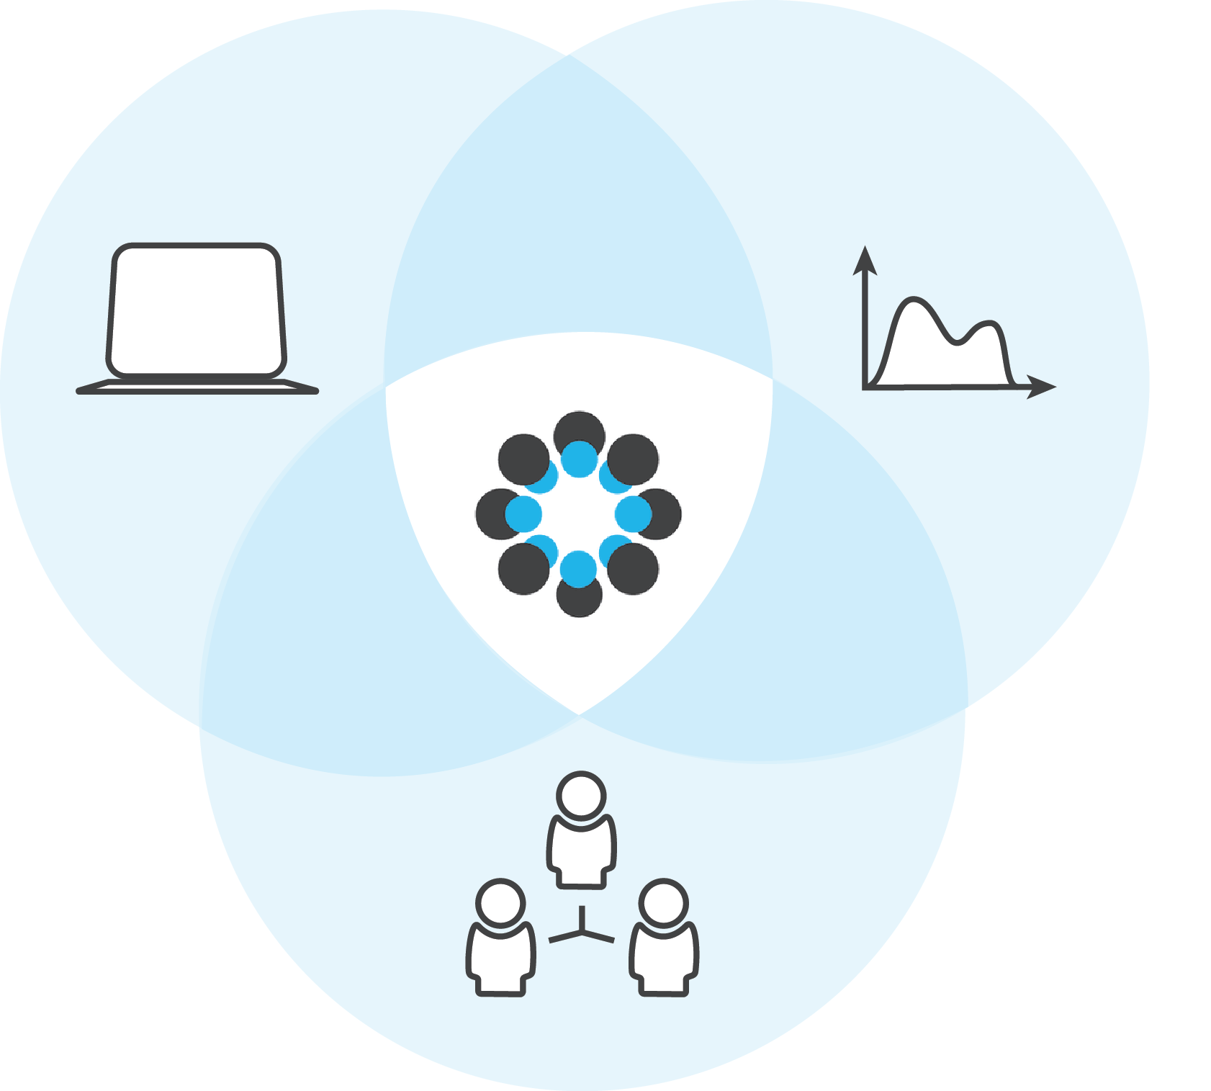
Infrastructure
Metascience
Community

Slide 9
COURSE OBJECTIVES
Describe benefits of open and reproducible research practices
Understand emerging incentives for those practices
Create a collaborative project on the OSF and customize it to meet your needs
Notes:
You are free to ask questions throughout the presentation, and we will try to remember
Red and green post its!

Slide 10
Why Reproducibility?
Notes:
How many have heard of a “Reproducibility crisis” ?

Slide 11
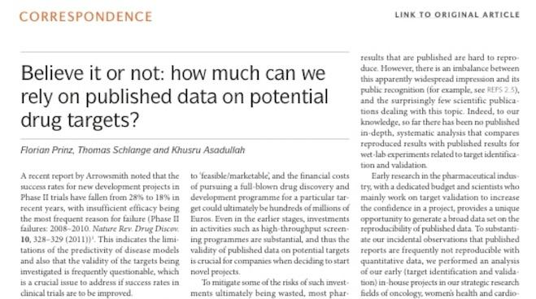
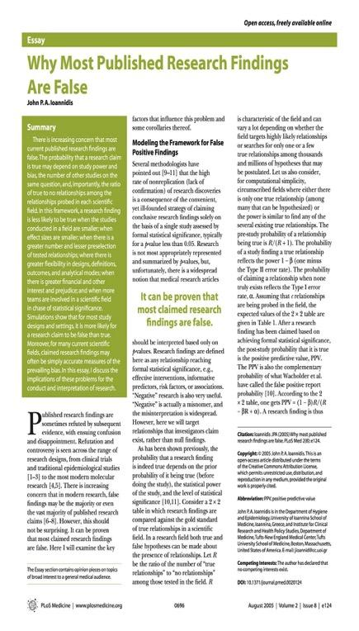
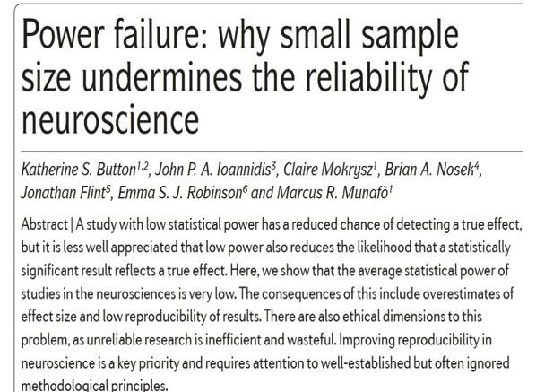
Notes:
Unfortunately, it has become apparent over the last few years that perhaps the answer to that question is “not all that much.”
Now, there have been some very prominent cases in the past few years of outright fraud, where people have completely fabricated their data, but I’m not talking about those case. What I’m talking is the general sense that many scientific findings in a wide variety of fields don’t replicate, and that the published literature has a very high rate of false-positives in it.
So if a large proportion of our published results aren’t replicable, and are potentially false positives, are we actually accumulating knowledge about real phenomena? I would suggest that the answer to this question is ‘no’, or at least we haven’t accumulated as much knowledge as we would like to believe.

Slide 12
SOURCES OF ISSUES IN REPRODUCIBILITY
Methodological, statistical, and reporting practices
Structural and organizational practices
Rarely, intentional scientific misconduct
Notes:
Methodological, statistical and reporting practices that results in overly tidy evidence
Structural and organizational practices that reult in unavailable, lost, or difficult to use data, code, and materials
Very rarely, cases of intentional scientific misconduct

Slide 13
WHAT IS REPRODUCIBILITY?
Computational Reproducibility:
If we took your data and code/analysis scripts and reran it, we can reproduce the numbers/graphs in your paper
Methods Reproducibility:
We have enough information to rerun the experiment or survey the way it was originally conducted
Results Reproducibility/Replicability:
We use your exact methods and analyses, but collect new data, and we get the same statistical conclusion

Slide 14
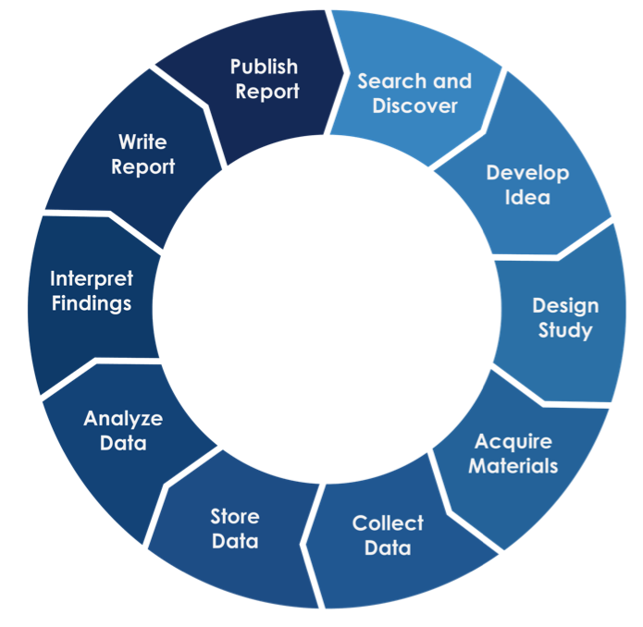
The Research Lifecycle
Notes:
There’s more to it than sharing of discrete objects. Think about using this as an opportunity to increase transparency by capturing the entire workflow, and to do so while connecting tools and services that make up the parts of the workflow, not requiring people to change all of their practices at once, and providing immediate efficiencies and value to the researcher AS they comply with requirements.
Easy, right? Obviously not.

Slide 15
WHY SHOULD YOU CARE?
Increases efficiency of your own work
Can reduce false leads
Data sharing citation advantage

Slide 16
“
It takes some effort to organize your research to be reproducible…the principal beneficiary is generally the author herself.
Jon Claerbout
Making Scientific Contributions Reproducible
http://sepwww.stanford.edu/oldsep/matt/join/redoc/web/iris.html
”
Notes:
Your most likely collaborator is yourself - in six months time.

Slide 17
FIND YOUR RESEARCH TEAM
(5 minutes)
Get into groups of 2-3 people and introduce yourselves to each other.
Looking over the 2012 ANES Questionnaire, develop a research question for your study. https://osf.io/ywv39/files/
Note: You’re not actually going to do this study.

Slide 18
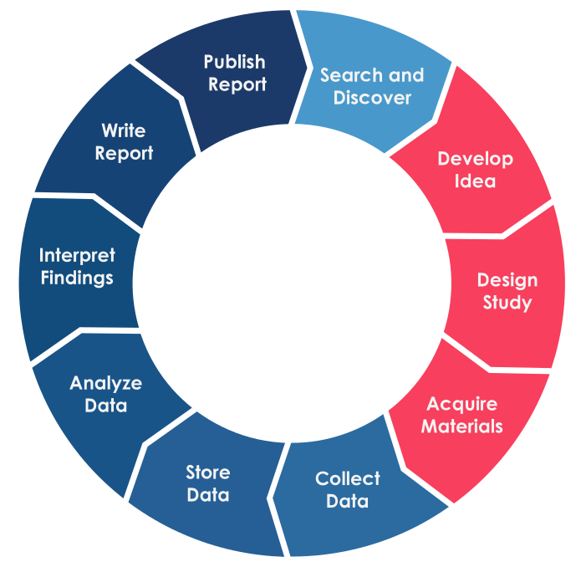
The Research Lifecycle
Notes:
This is where we are in the research lifecycle. Any questions?
Let’s turn to Research Management Planning

Slide 19
STEPS
Create a structured workspace
Notes:
Before the data collection
Lack of organization now can create big problems later

Slide 20
RESEARCH / DATA
MANAGEMENT PLANNING
What are you going to store?
Where and how are you going to store it
Who will have access to it?
When will they have access to it?

Slide 21
RESEARCH / DATA
MANAGEMENT PLANNING
PLAN AHEAD
What are you going to store?
Where and how are you going to store it
Who will have access to it?
When will they have access to it?
Checklists and common structures are your best friend!

Slide 22
Ledgerwood Lab Experimental Archive
https://ucdavis.app.box.com/s/f8hn7rqtwwf6aa6hjtkthdbiuehup312

Slide 23
RESEARCH / DATA
MANAGEMENT PLANNING
Could do this internally on a lab server, personal computer or website, but:
Makes eventual sharing more work
Unclear how stable/accessible that will be in the long run
Cross lab/institution collaborations harder

Slide 24
OPEN SCIENCE FRAMEWORK
http://osf.io
FREE, OPEN SOURCE

Slide 25
OPEN SCIENCE FRAMEWORK for UVA
https://osf.io/institutions/uva/
Notes:
GINNY
[30 sec - to 1 min]

Slide 26
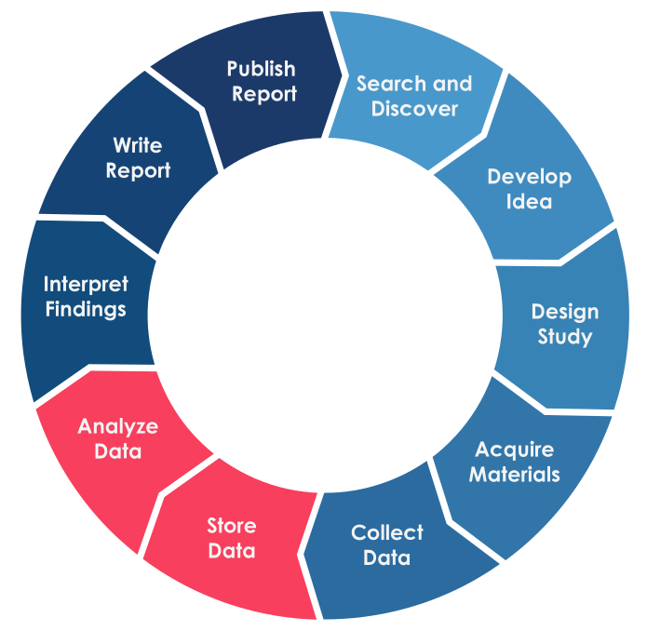
The Research Lifecycle
Notes:
There’s more to it than sharing of discrete objects. Think about using this as an opportunity to increase transparency by capturing the entire workflow, and to do so while connecting tools and services that make up the parts of the workflow, not requiring people to change all of their practices at once, and providing immediate efficiencies and value to the researcher AS they comply with requirements.
Easy, right? Obviously not.

Slide 27
STEPS
Create a structured workspace
Archive materials from study
Archive and document analyses

Slide 28
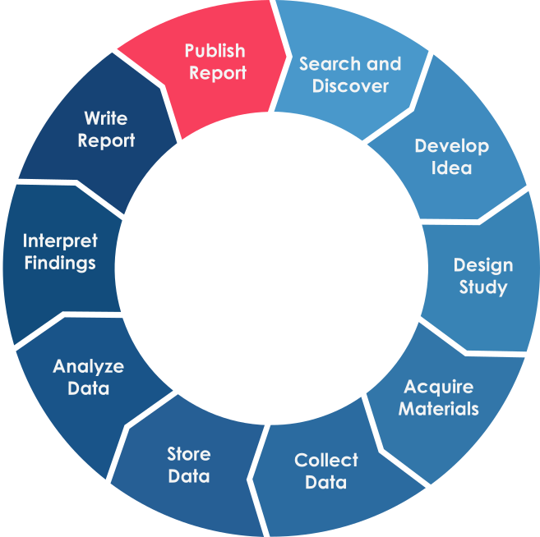
The Research Lifecycle
Notes:
There’s more to it than sharing of discrete objects. Think about using this as an opportunity to increase transparency by capturing the entire workflow, and to do so while connecting tools and services that make up the parts of the workflow, not requiring people to change all of their practices at once, and providing immediate efficiencies and value to the researcher AS they comply with requirements.
Easy, right? Obviously not.

Slide 29
STEPS
Create a structured workspace
Archive materials from study
Archive and document analyses
Share study data, code, and materials

Slide 30
WHAT TO SHARE
Sharing is a continuum
Data underlying just results reported in a paper
Data underlying publication + information about other variables collected
Data underlying publication + embargo on full dataset
All data collected for that study

Slide 31
How to share on the OSF

Slide 32
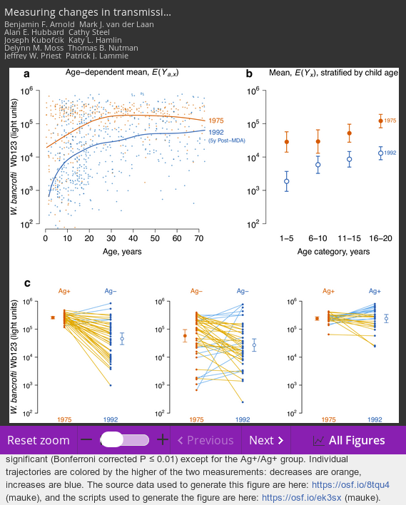
GUIDs MAKE SHARING SIMPLE
The source data used to generate this figure are here: https://osf.io/8tqu4 (mauke), and the scripts used to generate the figure are here: https://osf.io/ek3sx (mauke).
Arnold BF, van der Laan MJ, Hubbard AE, Steel C, Kubofcik J, Hamlin KL, et al. (2017) https://doi.org/10.1371/journal.pntd.0005616

Slide 33
WHY YOU MIGHT WANT TO SHARE
Journal/funder mandates
Increase impact of work
Get recognition for your good research practices

Slide 34
FEELING OVERWHELMED?
You don’t have to do all of this at once:
One piece at a time
Series of small steps
Even incremental changes can have significant impact

Slide 35
NEXT STEPS
Build a test project on the OSF
Document from the beginning - or even right now
Talk to your collaborators
What is our data management plan?
What/when will we share?

Slide 36
WHERE TO GET HELP
Center for Open Science YouTube channel
FAQ/OSF guides: https://osf.io/support
Local help: Questions about reproducible research, data management or Institutional use of OSF
shlake@virginia.edu or ricky@virginia.edu
Slides & Files from this workshop https://osf.io/j3nw6/

Slide 37
ADDITIONAL SLIDES
Slides for Registration and Badges

Slide 38
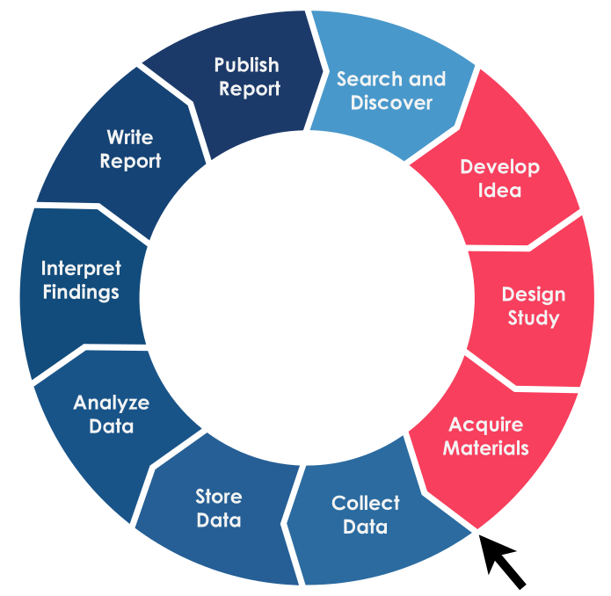
The Research Lifecycle
Notes:
So we have designed our study and set up our collaborative working environment. There is one important step we can now take that is not listed in the general research lifecycle. Somewhere after Study Design and before Collect Data we can take one more documentation step to improve the openness and reproducibility of our work: preregistration.
Easy, right? Obviously not.

Slide 39
STEPS
Create a structured workspace
Preregister study
Document research plan
Document a pre-analysis plan (if confirmatory)
Notes:
Preregistration can have a couple of steps depending on what kind of research you are doing. We will cover the different options one by one.

Slide 40
PREREGISTRATION
Documenting your research plan in a read-only public repository before you conduct the study.
Practice originated in clinical research and is now expanding more broadly
Notes:
What is preregistration?

Slide 41
PREREGISTRATION
Benefits of preregistering your study depend on how much information you include. At a minimum a preregistration should include the “what” of the study:
Research question
Population and sample size
General design
Variables you’ll be collecting, or dataset you’ll be using

Slide 42
WHY PREREGISTER?
Preregistration helps reduce the “file drawer effect” by increasing discoverability of unpublished studies

Slide 43
WHY PREREGISTER?
Preregistration helps reduce the “file drawer effect” by increasing discoverability of unpublished studies
Studies that are never published are lost to the “file drawer effect”
Notes:
What kind of studies are never published? Disproportionately studies that show a null or negative result. Called publication bias.

Slide 44
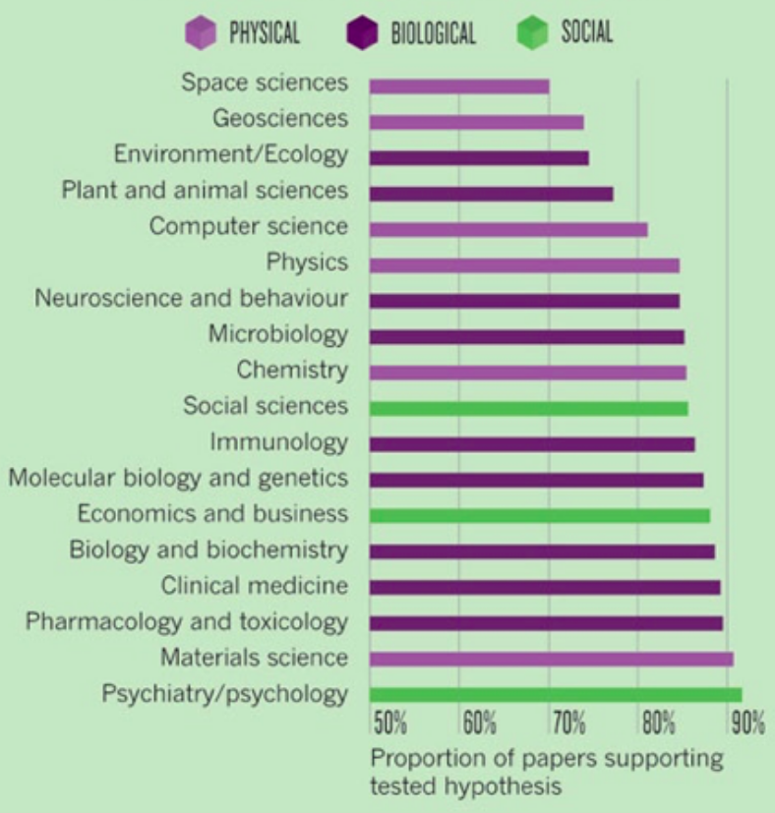
POSITIVE RESULTS BY DISCIPLINE
Fanelli D (2010) “Positive” Results Increase Down the Hierarchy of the Sciences. PLOS ONE 5(4): e10068. doi:10.1371/journal.pone.0010068
http://journals.plos.org/plosone/article?id=10.1371/journal.pone.0010068
Notes:
By presenting a more complete picture of all research in a field, regardless of that research’s outcome, preregistration can help address some of the negative effects of this publication bias:
Avoid duplication of work
Identify areas of study that present unexpected challenges for researchers
Let’s go ahead and add some of our basic study design information to our project’s wiki on the OSF.

Slide 45
ADD DETAILS TO YOUR OSF PROJECT
Study population: ANES 2012 Dataset
Sample size: 199 subjects
What variables will you use?
Notes:
In preparation for preregistering, let’s go ahead and fill in some missing details about our basic study design.
Go to your project wiki and add in the dataset we are using, which is the ANES 2012 dataset, our sample size, which is 199, and write in whatever variables you choose as part of your group’s research question. Mine are going to be “self-reported gender” and “self-reported political ideology”.
Hit “save.
----
[Transition from OSF back to slides] “The information entered here is the minimum for a preregistration. We have just enough information to tell someone what we are studying. If we want to test a hypothesis in our research we can also document our plan for data analysis, which is called a ‘pre-analysis plan’.”

Slide 46
PRE-ANALYSIS PLAN
Details the analyses planned for hypothesis testing:
Sample size
Data processing and cleaning procedures
Exclusion criteria
Statistical analyses
Including a pre-analysis plan in your preregistration helps decrease researcher degrees of freedom

Slide 47
RESEARCHER DEGREES OF FREEDOM
All data processing and analytical choices made after seeing and interacting with your data
Should I collect more data?
Which observations should I exclude?
Which conditions should I compare?
What should be my main DV?
Should I look for an interaction effect?
Notes:
Who has heard of RDF? What about P-Hacking or “data fishing”? All refer to the same general issue outlined here, which is making decisions about how to analyze data after interacting with that data.
These questions are all perfectly legitimate decisions for a researcher to make, they are the same ones we ask you to document in your pre-analysis plan, but once we have started interacting with data, any changes we make to our analysis plan can significantly undermine the strength of our work.

Slide 48
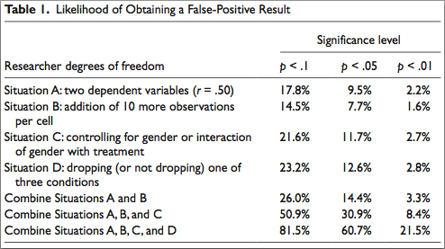
False Positive Inflation
Simmons, Nelson, & Simonsohn (2011)
Notes:
The results from this 2011 study help show the potential consequences of making data-dependant analysis choices. Study used computer generated data that contained no actually significant relationships. False positive rate should have been less than 5%.
By making a series of small changes to the analysis plan, the false positive rate can go all the way above 60%.
The danger here is just how reasonable these decisions can seem in the middle of conducting a study. Unless we take proactive steps to document our analysis plan and any changes to it, we may be unable to even know where in this range of values our own work falls.
That can make our results impossible to reproduce and potentially waste years of our lives if we pursue follow up research based on these inflated results.
this is also assuming your initial false positive rate was .05, which may not be true given that we often work with somewhat unreliable measures, low powered studies, and don’t often treat sitmuli as random factors which can all also increase false positive rates

Slide 49
The first principle is that you must not fool yourself, and you are the easiest person to fool. After you’ve not fooled yourself, it’s easy not to fool other scientists. You just have to be honest in a conventional way after that.
“
”
Richard P. Feynman
Cargo Cult Science, (1974)
Notes:
We as humans process information in biased fashion.
We interpret new information in ways that fit our existing beliefs and perceptions.
No one is a purely objective observer.
That is why we need *procedural* solutions like preregistering your study design and analysis plan.

Slide 50
WHY PREREGISTER?
Preregistration helps reduce the “file drawer effect” by increasing discoverability of unpublished studies
Preregistered analysis plans help improve study accuracy and replicability by guarding against unintended false positive inflation.
Notes:
So now we have an additional reason to preregister when we are testing hypotheses. Now that we have explored some reasons, and added some study design information to our OSF project, lets take a look at how to preregister our project.

Slide 51
STEPS
Create a structured workspace
Preregister study
Document research plan
Document a pre-analysis plan (if confirmatory)
Make public snapshot

Slide 52
How to Preregister on the OSF

Slide 53
EXPLORATORY VS. CONFIRMATORY ANALYSES
Exploratory
Interested in exploring possible patterns/relationships in data to develop hypotheses
Confirmatory
Have a specific hypothesis you want to test

Slide 54
EXPLORATORY VS. CONFIRMATORY ANALYSES
Exploratory
Interested in exploring possible patterns/relationships in data to develop hypotheses
Confirmatory
Have a specific hypothesis you want to test
Preregistered analysis plans clarify which results are exploratory and which are confirmatory

Slide 55
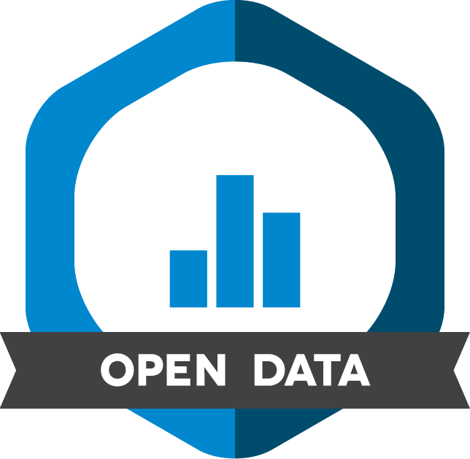
SIGNALS: MAKING BEHAVIORS VISIBLE PROMOTES ADOPTION
https://cos.io/badges
Notes:
Badges
Open Data
Open Materials
Preregistration
Psychological Science (Jan 2014)

Slide 56
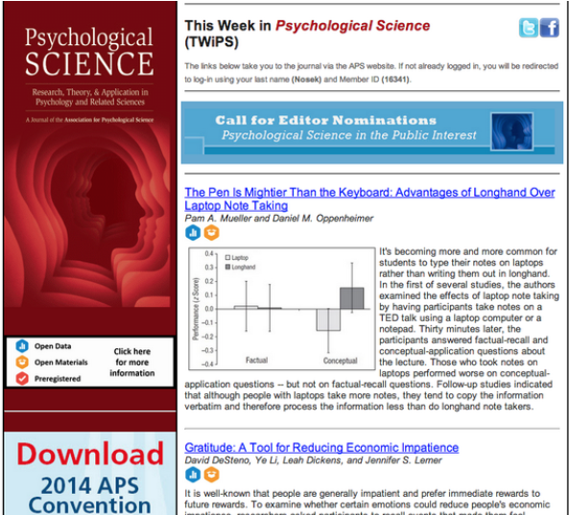
Psychological Science: the first journal to adopt Badges
Notes:
Also have an initiative to get journals ot adopt review of pre-registered reports of publications, so not even publication decisions are data dependent, but are made instead on the solidness of theory, study design, and analyses

Slide 57
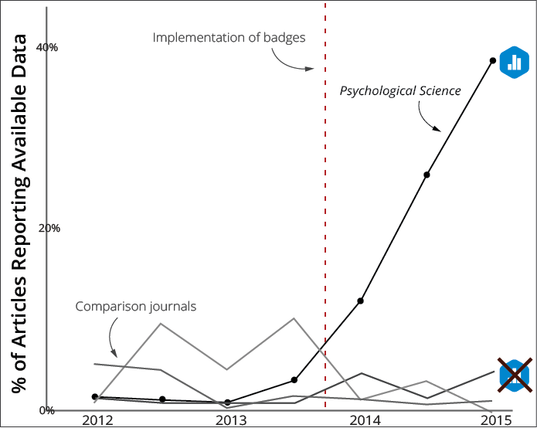
DATA AVAILABILITY IN PSYCHOLOGICAL SCIENCE
Kidwell et al. 2016. PLoS Biology, 14(5), e1002456. doi: 10.1371/journal.pbio.1002456
Notes:
10x increase from 2013 to 2015
Kidwell, M. C., Lazarevic, L. B., Baranski, E., Hardwicke, T. E., Piechowski, S., Falkenberg, L-S., Kennett, C., Slowik, A., Sonnleitner, C., Hess-Holden, C., Errington, T. M., Fiedler, S., & Nosek, B. A. (2016). Badges to acknowledge open practices: A simple, low-cost, effective method for increasing transparency. PLoS Biology, 14(5), e1002456. doi:10.1371/journal.pbio.1002456

Slide 58
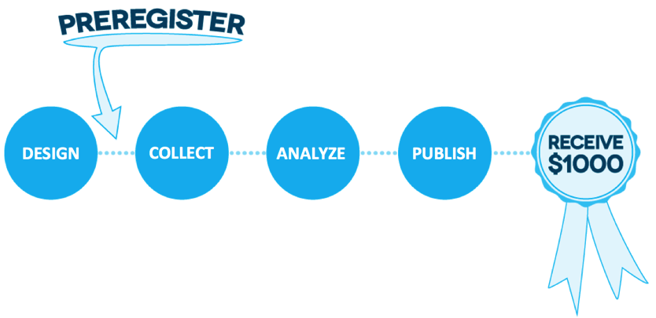
$1,000,000 PREREGISTRATION CHALLENGE
Notes:
Another incentive for researchers to try out preregistration.

Slide 59
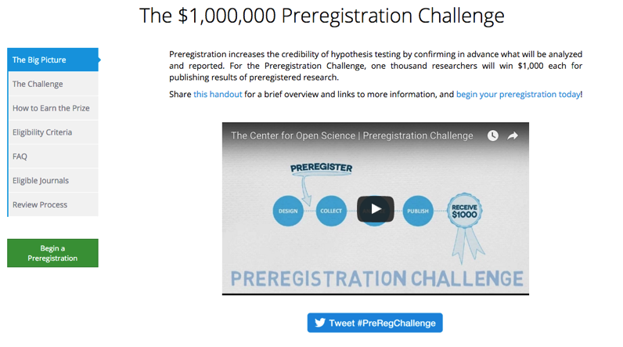
$1,000,000 PREREGISTRATION CHALLENGE
https://cos.io/prereg

Slide 60
TRADITIONAL ACADEMIC PUBLISHING MODEL
https://cos.io/rr
Notes:
Review of intro and methods prior to data collection; published regardless of outcome
Beauty vs. accuracy of reporting
Publishing negative results
Conducting replications
Peer review focuses on quality of methods

Slide 61
REGISTERED REPORTS
https://cos.io/rr
Notes:
Review of intro and methods prior to data collection; published regardless of outcome
Beauty vs. accuracy of reporting
Publishing negative results
Conducting replications
Peer review focuses on quality of methods

Slide 62
REGISTERED REPORTS
Adv in Mthds & Practices in Psyc Sci
AIMS Neuroscience
Attention, Percept., & Psychophys
Cognition and Emotion
Cognitive Research
Comp. Results in Social Psychology
Cortex
Drug and Alcohol Dependence
eLife
Euro Journal of Neuroscience
Experimental Psychology
Infancy
Int’l Journal of Psychophysiology
Journal of Accounting Research
Journal of Business and Psychology
Journal of Cogn. Enhancement
Journal of Euro. Psych. Students
Journal of Expt’l Political Science
Journal of Personnel Psychology
Journal of Media Psychology
Leadership Quarterly
Nature Human Behaviour
Nicotine and Tobacco Research
NFS Journal
Nutrition and Food Science Journal
Perspectives on Psych. Science
Royal Society Open Science
Social Psychology
Stress and Health
Work, Aging, and Retirement
more at https://cos.io/rr
Notes:
Review of intro and methods prior to data collection; published regardless of outcome
Beauty vs. accuracy of reporting
Publishing negative results
Conducting replications
Peer review focuses on quality of methods

Slide 63
ADDITIONAL SLIDES
The slides that follow provide additional information and can be displayed as needed.

Slide 64
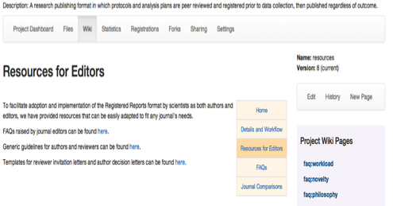
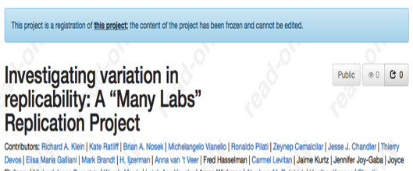
REGISTERED REPORTS COMMITTEE
cos.io/rr
Notes:
COS helps coordinate a committee of editors and others interested in the format - committee led by Chris Chambers (University of Cardiff)
The RR’s committee maintains best practices for RR’s and tracks use of RR’s by journals- Variations include an open submission format for any preregistered research, RR’s focused on replication with open calls for participating labs, and special issues focused on RR’s
Committee also provides resources to the community: guidelines + templates for editors; comparisons of features by journals for authors + researchers.
Goal: easy adoption.

Slide 65
EARLY ADOPTERS
AIMS Neuroscience
Attention, Perception & Psychophysics
Comparative Political Studies
Comprehensive Results in Social Psychology
Cortex
Drug and Alcohol Dependence
eLife
Experimental Psychology
Frontiers in Cognition
Journal of Business and Psychology
Nutrition and Food Science Journal
Perspectives on Psychological Science
Social Psychology
Working, Aging, and Retirement

Slide 66
CONNECTING SILOS TO ENABLE INCREASED DISCOVERY

Slide 67
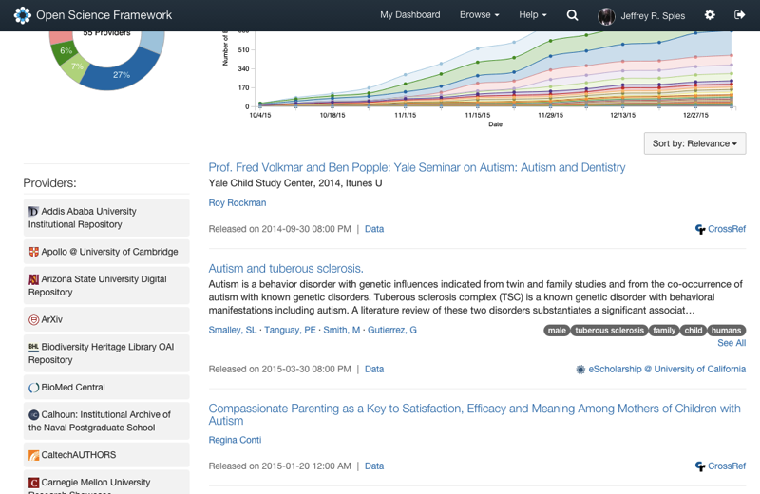
SHARE
osf.io/share

Slide 68
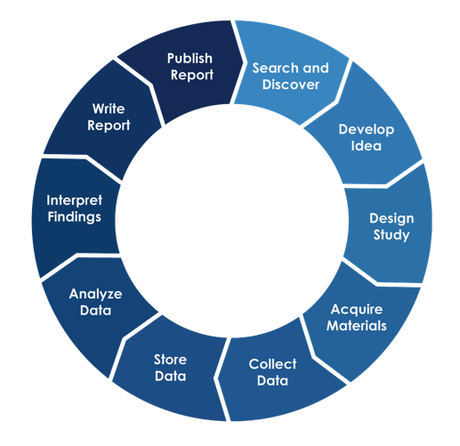
OSF
OpenSesame

Slide 69
Grant administration
Institutional
repositories
and
reporting
OSF
IRB
processes
HPC
clusters
OpenSesame
Custom data collection workflows
Local data storage
Data
management

Slide 70
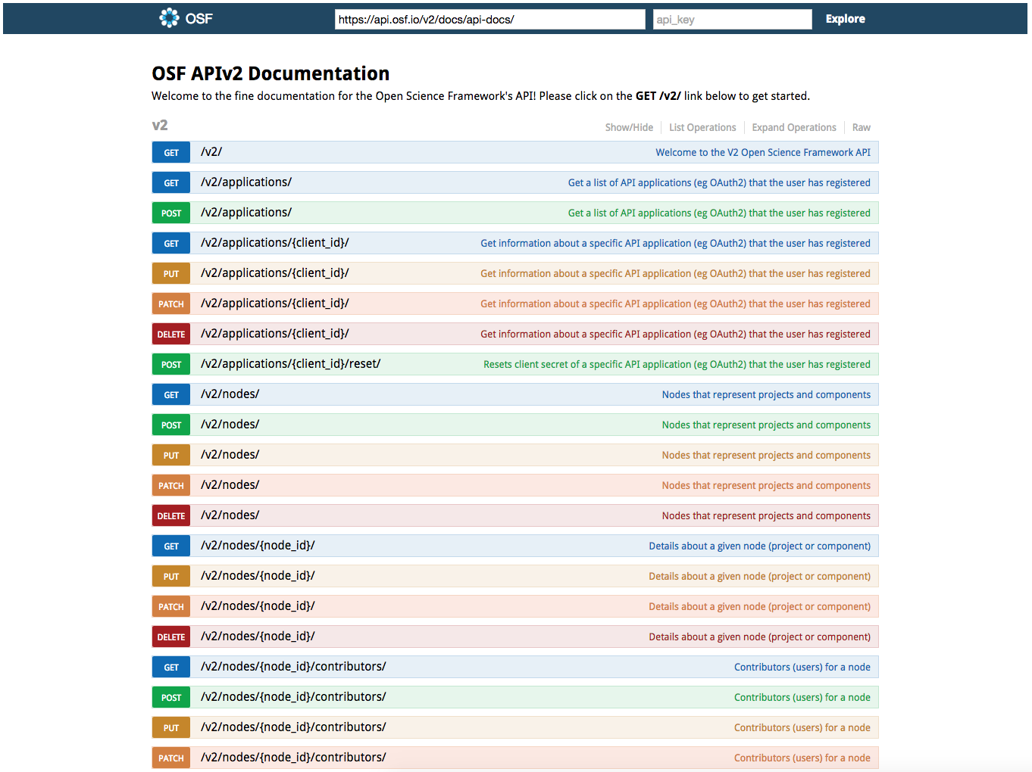
API DOCS
https://api.osf.io/v2/docs/
Notes:
Localized connections are now possible with the OSF API.

Slide 71
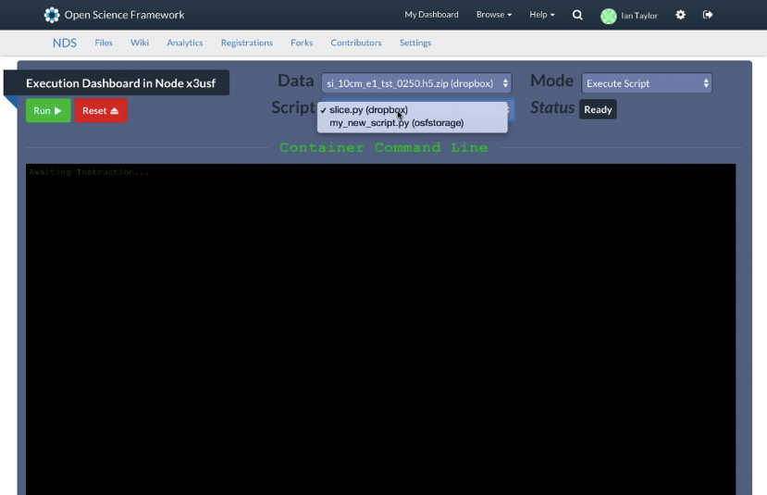
Awaiting Instruction…

Slide 72
SLIDES for OFFLINE PRESENTATION
The slides follow the curriculum and can be used to present course content in the event of a wifi failure

Slide 73
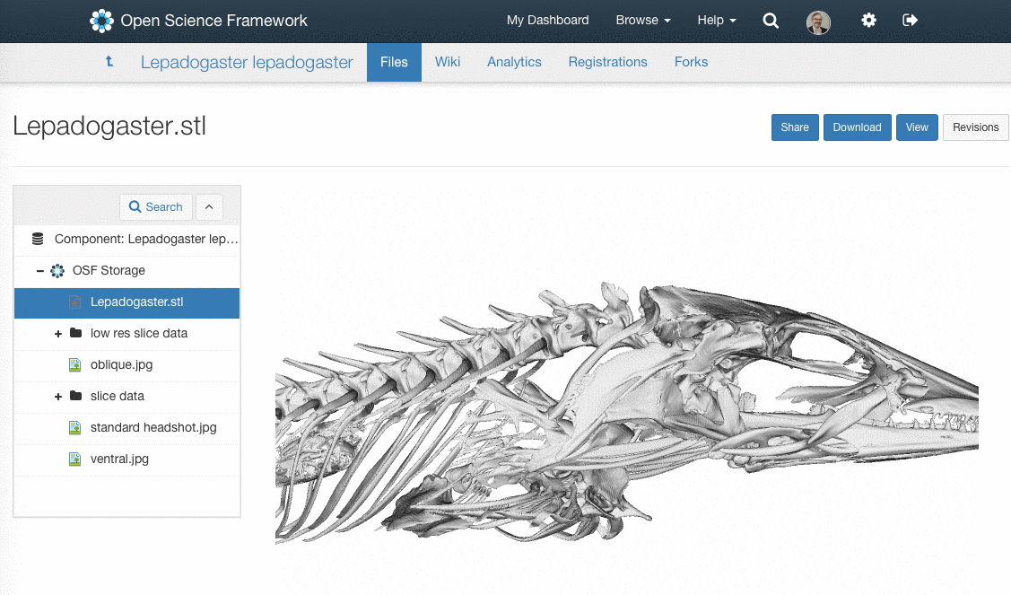
PUT DATA, MATERIALS, AND CODE ON THE OSF

Slide 74
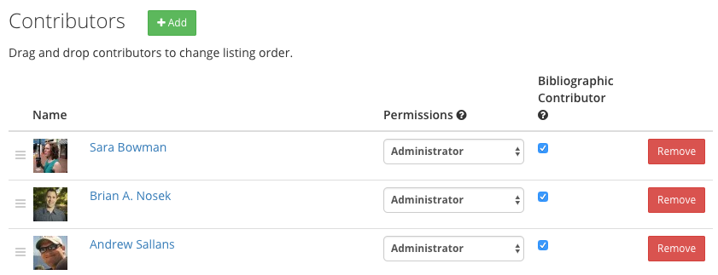
MANAGE ACCESS AND PERMISSIONS

Slide 75
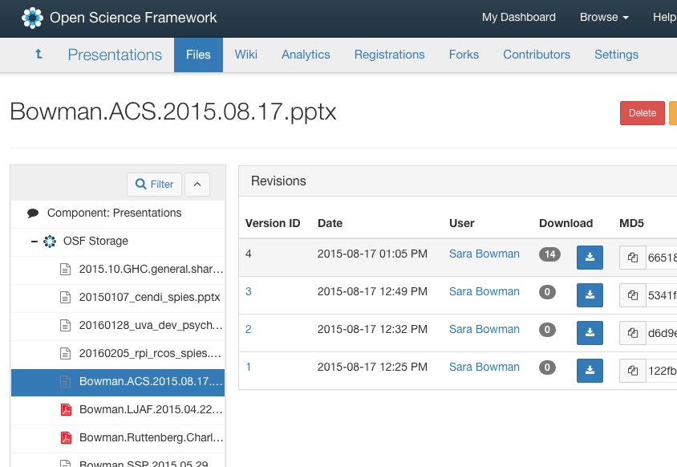
AUTOMATE VERSIONING
recent and previous versions of file

Slide 76
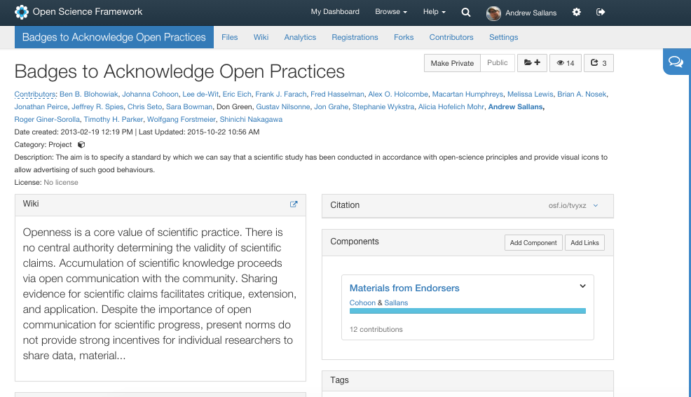
SHARE YOUR WORK

Slide 77
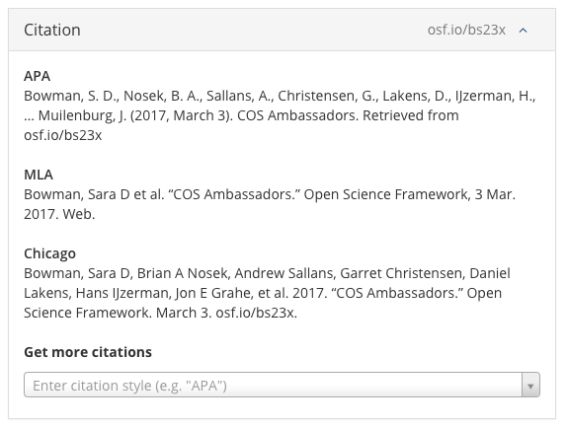
GET A PERISISTENT IDENTIFIER
persistent identifier
used in a citation

Slide 78
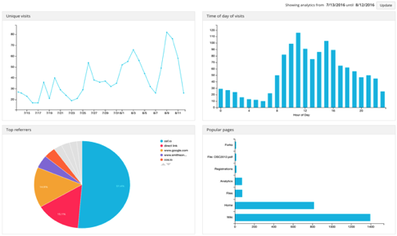
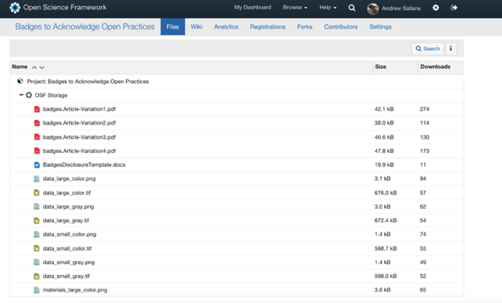
ANALYTICS
File downloads
Forks

