Slide 1
Introduction to the Command Line: Basic Commands
Ricky Patterson
University of Virginia Library
ricky@virginia.edu

Slide 2
What We Will Learn
The fundamental commands of the Unix operating system.
Everything here is also applicable to the Linux operating system. I will refer to both of these as *nix systems.

Slide 3
Introduction to the Shell
Basic *nix Commands
Directory Structure
Viewing/Manipulating Text Files
Advanced *nix Commands
File Permissions
Redirections/Pipes
Wildcards
Help

Slide 4
What Is *nix?
*nix is a computer operating system, a control program that works with users to
run programs,
manage resources, and
communicate with other computer systems.
*nix systems are
Multiuser: Several people can use a *nix computer at the same time
Multitasking: Any of these users can also run multiple programs at the same time
Plain Text Data Storage
Hierarchical File System

Slide 5
How do you get *nix?
Linux and macOS are built on Unix, so it is available natively on these operating systems. On a Mac, you will use Terminal to interact with the shell.
Windows 10 and 11 (64-bit) now allow you to activate the Windows Subsystem for Linux (WSL). You need to be an administrator of your computer in order to do this.
https://docs.microsoft.com/en-us/windows/wsl/install
Alternatively, you can install a Linux Virtual Machine under Windows, but WSL is much more straightforward.

Slide 6
Command Line of *nix
When you first log into a *nix (Unix or Linux) system, you are presented with something that looks like this, or this:
(base) UL-RJP0I-MBP13:~ rjp0i$
bash-3.2$
That “something” is called a prompt. It is prompting you to enter a command.
Every *nix command is a sequence of letters, numbers and characters. (There are no spaces in a command name itself).
*nix is also case-sensitive. This means that cat and Cat and CAT are all different.

Slide 7
The Shell
The prompt is displayed by a special program called the shell.
Shells accept commands and run those commands.
Shells can also be programmed in their own language. These programs are called “shell scripts”. Shell scripts are powerful, but beyond the scope of this introduction.

Slide 8
The Shell
When you first login, the prompt is displayed by the default shell, and you are running your first *nix program. (This might be bash, or zsh, or…)
If you remain logged in, the shell will constantly be running (unless you choose to change to another shell).
Other shells available include csh, tcsh, ksh, zsh and fish. They all behave very similarly but have differences/quirks that appeal to different users.

Slide 9
Storing Information - Directories
*nix arranges the system into files and directories.
A directory is like a folder: it contains pieces of paper, or files.
A large folder can even hold other folders-directories can be inside directories.
In *nix, the collection of directories and files is called the file system. Initially, the file system consists of one directory, called the “root” directory
Inside the “root” directory, there are more directories, and inside those directories are files and yet more directories.

Slide 10
Each file and each directory have a name.
A short name for a file could be penguin,
while it’s “full name” could be /home/bird/penguin The full name is usually called the path.
The path can be divided into a sequence of directories.
For example, here is how /home/bird/penguin is read:
The initial slash indicates the root directory.
/home/bird/penguin
This signifies the directory called home. It is inside the root directory.
The second slash corresponds to the
directory bird, which is inside home.
penguin is inside bird.

Slide 11
A path may refer to either a directory or a filename, so fish could be either.
All the items before the short name must be directories.
Root Directory “/”
Directory
Directory
/home
Sub-Directory
penguin
File
Directory structure
File
Sub-directory
fish

Slide 12
Moving around on the command line
Ctrl+A Move to beginning of line
Ctrl+E Move to end of line
Ctrl+L Clear the screen
Ctrl+U Clear the line before the cursor position
Ctrl+K Clear the line after the cursor position
Ctrl+C Kill the command that is currently running
Ctrl+D Exit the current shell
Alt+F (or Esc+F) Move cursor forward one word
Alt+B (or Esc+B) Move cursor backward one word

Slide 13
Getting Help
*nix Commands
The man command displays reference pages for the command you specify.
The *nix man pages (man is short for manual) cover every command available.
To search for a man page, enter man followed by the name of the command.
For example:
bash-3.2$ man ls

Slide 14
To view more, press spacebar
To exit, press “q”

Slide 15
Getting Help: man
There is also a keyword function in man.
For example;
If you are interested in any commands that deal with Postscript, the printer control language for Adobe
Type man -k ps or man -k Postscript,
you’ll get a listing of all commands, system calls, and other documented parts of *nix that have the word “ps” (or “Postscript”) in their name or short description.
This can be very useful when you’re looking for a tool to do something, but you don’t know its name - or if it even exists!

Slide 16
Looking at Directories with Is
The command ls lists files.
If you try ls as a command, it will list the files (and directories) contained in the current directory.
If you have files, ls lists the names of files in the directory

Slide 17
Looking at Directories with Is
If you want a list of files of a more active directory, try the root directory.
“/” is an argument saying what directory you want a list for. In
this case, it is the top-level directory “/”
But you can replace the “/” with other arguments. Try using “/home”

Slide 18
Looking at Directories with Is
Many commands have options in addition to arguments. Try:
The -F is an option. It displays file types.

Slide 19
Aside: Command Options
An option (sometimes called a switch or a flag) always starts with a dash “-”
An option modifies how the program runs, but not what the program runs on.
For ls, -F is an option that lets you see which things are directories, which ones are special files, which are programs, and which are normal files.
Anything with a trailing slash “/” is a directory.

Slide 20
Aside: Command Options
Many *nix commands are like ls.
They have options, which are generally one character after a dash, and they have arguments.
Unlike ls, some commands require certain arguments and/or options.
Some options can be given as words, rather than letters. If this is the case, it is used with a double dash: lpr --help

Slide 21
Navigating Directories
pwd
pwd (present working directory) tells you your current directory.
Note: Most commands act, by default, on the current directory. For instance, ls without any arguments displays the contents of the current directory.
cd
cd is used to change directories.
The format of this command :
cd new-directory (where new-directory is the name of the new directory you want).

Slide 22
To see autocomplete *nix command names, press Tab key
If you want to learn commands beginning with c you can write c then press Tab key
…and 104 more commands…
Now, what happens if you type “h” after the “c” and press Tab again?

Slide 23
mkdir
mkdir (make directory) is used to create a new directory,
It can take more than one argument, interpreting each argument as another directory to create.
By default, it will create the new directory as a subdirectory of the current directory
rmdir
rmdir (remove directory) is used to remove a directory,
rmdir will refuse to remove a non-existent directory, as well as a directory that has anything in it.
Notes:
Try this, make a directory now, create one called larry.

Slide 24
And now, let’s return to cd. Try this:
bash-3.2$ cd /larry
bash-3.2$
If you omit the optional argument directory, you’re returned to your home, or original directory (the same as typing cd ~ ). Otherwise, cd will change you to the specified directory.
There are two directories used only for relative pathnames:
The directory “.” refers to the current directory
The directory “..” refers to the parent directory of the current directory
The directory “..” is most useful moving back up a directory: cd ..
The command “cd –” will return you to the most recent directory visited.
Notes:
Double check where you are with pwd!

Slide 25
Moving Files/Directories
The primary commands for manipulating files under *nix are cp, mv, and rm. They stand for copy, move, and remove, respectively.
cp
cp is used to copy contents of file1 to file2
cp file1 file2 (contents of file1 is copied to file2 in the same directory)
cp folder1/file1 folder2 (contents of file1 is copied to file1 in the inside of folder2 directory)

Slide 26
rm
rm is used to remove a file.
rm filename ---> removes a file named filename
mv
mv is used to move a file.
mv filename /path/newname ---> moves a file named filename to a new location, with a new name
looks like cp, except that it deletes the original file after copying it.
mv will rename a file if the second argument is a file. If the second argument is a directory, mv will move the file to the new directory, keeping it’s shortname the same.

Slide 27
Operating on Files
In addition to the commands like cd, mv, and rm, we learned in the directories discussion, there are other commands that just operate on files, but not the data in them.
These include touch, chmod.
None of these commands care what is within the file.

Slide 28
Permissions
Recall ls
ls –l displays all details (long listing)

Slide 29
Permissions
Some of the things these commands can manipulate (most are shown by ls –l):
The time stamp: Each file has three dates associated with it. These are creation time, last modification time and last access time.
The owner: the owner of files
The group: the group of users
The permissions: read, write, execute permissions of files. The permissions tell *nix who can access what file, or change it, or, in the case of programs, execute it. Each of these permissions can be toggled separately for the owner, the group, and all the other users.

Slide 30
Permissions
Entry type
owner
group
drwxr-xr-x 2 rjp users 6 Dec 6 2020 file.txt
time stamp
file name
owner
group
others
read, write, execute permissions of files
touch
touch will update the time stamps of the files listed on the command line to the current time.
If a file doesn’t exist, touch will create it.

Slide 31
Permissions: chmod
chmod (change mode) is used to change the permissions on a file.
(owner) (group) (others)
chmod [number][number][number] file1
Number = (read)4 + (write)2 + (execute)1
Example: chmod 754 file1
for owner: read, write and execute permissions (4+2+1)
for group: read and execute permissions (4+0+1)
for others: only read permission (4+0+0)

Slide 32
Examining Files
There are two major commands used in *nix for listing files, cat, and more (and less). head and tail are also useful.
cat
cat shows the contents of the file.
cat [-nA] [file1 file2 . . . fileN]
cat is not a user-friendly command-it doesn’t wait for you to read the file and is mostly used in conjunction with pipes.
However, cat does have some useful command-line options. For instance, n will number all the lines in the file, and A will show control characters.

Slide 33
Examining Files: more and less
more
more is much more useful, and is the command that you’ll want to use when browsing ASCII text files
more [-l] [+linenumber}] [file1 file2 ... fileN]
A useful option is l, which will tell more that you aren't interested in treating the character Ctrl-L} as a ``new page” character. more can also start on a specified line number.
less
less is similar to more but also allows you to scroll backwards or forward through a file. less also quickly loads a file and can operate on a file that is still being written to.
less > more or “less is more, more or less”

Slide 34
Examining Files: head and tail
head
head will display the first ten lines in the listed files.
head [- lines}] [l file1 file2 ... fileN]
Any numeric option will be taken as the number of lines to print, so head -15 frog will print the first fifteen lines of the file frog
tail
Like head, tail display only a fraction of the file.
tail also accepts an option specifying the number of lines.
tail [-lines] [l file1 file2 ... fileN]

Slide 35
More info about the file
These commands will search a file, perform certain operations on the file, or display statistics about the file.
grep
grep is the generalized regular expression parser.
This is a fancy name for a powerful utility which can only search a text file.
grep [-nvwx] [-number] { expression} [file1 file2 ... fileN]

Slide 36
More info about the file
diff
The GNU version of diff has over twenty command line options. It shows you what the differences are between two files
diff file1 file2

Slide 37
Some Other *nix Commands
The Power of *nix
The power of *nix is hidden in small commands that don’t seem too useful when used alone, but when combined with other commands produce a system that’s much more powerful, and flexible than most other operating systems.
The commands include sort, grep, more, cat, wc, spell, diff, head, and tail.

Slide 38
Putting it all Together
Combining *nix commands greatly expands your ability to interrogate and manipulate files.
So far, we have just output the results of commands to the screen.
Let’s now redirect the output of a command to a file, and pipe the output of a command into another command

Slide 39
Putting it all Together
Redirects
COMMAND > filename
Create a new file called filename, and fill it with the output of COMMAND
If filename already exists, it will be overwritten
COMMAND >> filename
Append the output from COMMAND to an existing file called filename
COMMAND < filename
Redirect the contents of the existing file called filename into a command called COMMAND

Slide 40
Putting it all Together
Pipes
COMMAND1 | COMMAND2
Run COMMAND1 and feed the output into COMMAND2
Consider the following series of commands
ls /home/larry/joe > filelist.txt
wc –l filelist.txt
They can be rewritten as a simple piped series of commands:
ls /home/larry/joe | wc -l

Slide 41
Altering a file
*nix has many commands that allow you to change the contents of a file, without manually open it in an editor
nano is a simple text editor. There are many text editors available. Some require graphical interfaces. Many are context aware (autocomplete programming commands, indent and color code text). But nano is simple:
nano file
nano

Slide 42
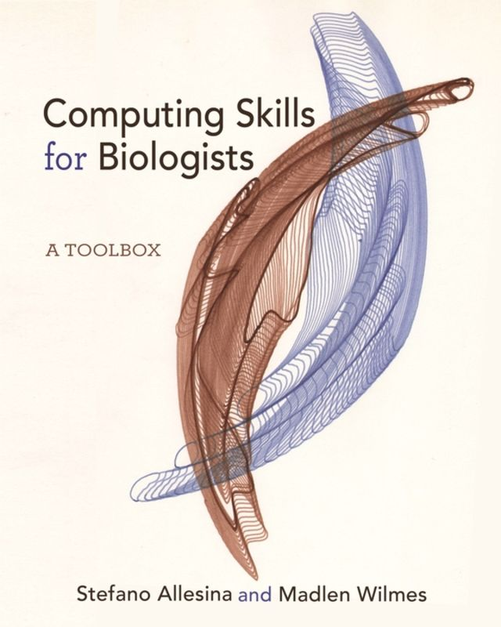
More help
Chapter 1 of
Computing Skills for Biologists (Allesina & Wilmes)
See Virgo for free access to ebook
See website for downloads https://computingskillsforbiologists.com
Clone their git repository for examples: git clone https://github.com/CSB-book/CSB.git
This book is not just for biologists but is valuable for graduate students in any datacentric field. It covers R, Python, Regular Expressions, version control, LaTeX, SQL, and the command line.

Slide 43
More help
LinkedIn Learning free courses, including:
“Learning Linux Command Line”
“Unix for Mac OS X Users”
Be sure to access LL materials for free by using the Library’s Research Portal to take advantage of the UVA subscription: https://www.library.virginia.edu/research/
Lots of online resources (unix.stackexchange…)
http://www.doc.ic.ac.uk/~wjk/UnixIntro/
Me – Please contact me (ricky@virginia.edu)

Slide 44
Permissions: chmod
chmod can also be set in alpha mode (non-octal)
(owner) (group) (others)
chmod [user/group/others/all]operator[permission] [file(s)]
operator can be +, -, or =
Example: chmod u+rwx,g+rx,o+r file1
for owner: read, write and execute permissions (u+rwx)
for group: read and execute permissions (g+rx)
for others: only read permission (o+r)

Slide 45
System Statistics
Commands in this section will display statistics about the operating system, or a part of the operating system.
du
du (disk usage) will count the amount of disk space for a given directory, and all its subdirectories take up on the disk.
df
df (disk filling) summarizes the amount of disk space in use.
For each file system, it shows the total amount of disk space, the amount used, the amount available, and the total capacity of the file system that’s used.

Slide 46
cat
cat command is used to concatenate or displays the contents of a file.
To use it, type cat, and then press enter key:
bash-3.2$ cat
This starts the cat program.
bash-3.2$ cat
Help, I’m stuck inside a *nix program!
Help, I’m stuck inside a *nix program!
If you type this row and then press enter
Then the next line of text is what we just typed into cat
To end many *nix commands, type the end-of-file command (EOF) [hold down the key labeled “Ctrl” and press “d” (Ctrl+d) Windows: Ctrl-Z]

Slide 47
To display the contents of a file, type
cat filename
bash-3.2$ cat program.c
/* C program howdy
First program */
int main()
{
printf(“My first C program\n”);
return 0;
}
bash-3.2$

Slide 48
More info about the file
file
file command attempts to identify what format a particular file is written in.
file [file1 file2 ... fileN]
Since not all files have extensions or other easy to identify marks, the file command performs some rudimentary checks to try and figure out exactly what it contains.

Slide 49
More info about the file
wc
wc (word count) simply counts the number of words, lines, and characters in the file(s).
wc [-clw] [file1 file2 ... fileN]
The three options, clw, stand for character, line, and word respectively, and tell wc which of the three to count.
spell
spell is very simple *nix spelling program, usually for American English. spell is a filter, like most of the other programs we’ve talked about.
spell [file1 file2 ... fileN]

Slide 50
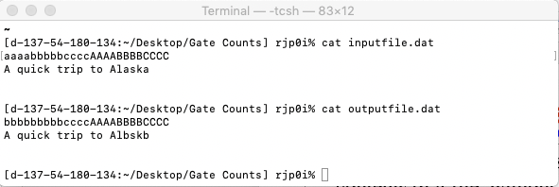
Altering a file
*nix has many commands that allow you to change the contents of a file, without manually open it in an editor
tr allows you to substitute characters within a file, sight unseen. To change every occurrence of “a” in a file with a “b” just type
cat inputfile.dat | tr “a” “b” > outputfile.dat
tr

Slide 51
Altering a file
tr
You can also change entire classes of characters
cat inputfile.dat | tr [:lower:] [:upper:] > outputfile.dat
cat inputfile.dat | tr a-c 1-3 “b” > outputfile.dat
cat inputfile.dat | tr 1-9 0 > outputfile.dat
cat inputfile.dat | tr “ ” “\t” > outputfile.dat
You can even delete all occurrences of a character
cat inputfile.dat | tr –d a > outputfile.dat
Or “squeeze” all occurrences of a character into a single occurrence
cat inputfile.dat | tr –s “a” > outputfile.dat

Slide 52
gzip [-v#] [file1 file2 ... fileN]
gunzip [-v] [file1 file2 ... fileN]
zcat [{file1 file2 ... fileN]
These three programs are used to compress and decompress data.
gzip, or GNU Zip, is the program that reads in the original file(s) and outputs files that are compressed, and therefore smaller.
gzip deletes the files specified on the command line and replaces them with files that have an identical name except that they have “.gz” appended to them.

